Slide 1
Yamini Ranganathan Rachel Porter Richa Patel
Comparison of Machine Learning Models for the Prediction of Cervical Cancer

Slide 2
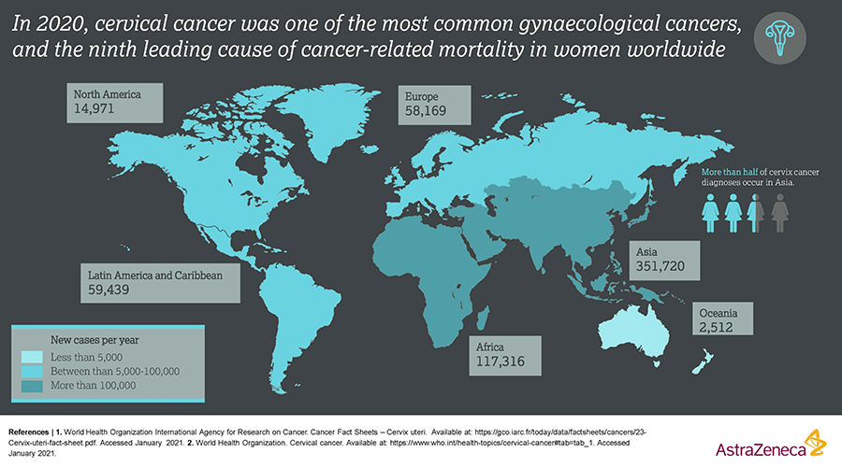
Introduction
Cervical cancer
4th most common cancer in women
605,000 new cases & 342,000 deaths worldwide in 2020
Symptom less nature of disease makes it difficult to diagnose at early stage
Many factors increase the risk of cervical cancer, such as age and use of hormonal contraceptives.

Slide 3
Statement of project objectives
Early detection of cervical cancer with ML models helps to raise recovery rates & reduce death rates
Our aim is to compare three different machine learning algorithms capable of diagnosing cervical cancer with high accuracy and sensitivity

Slide 4
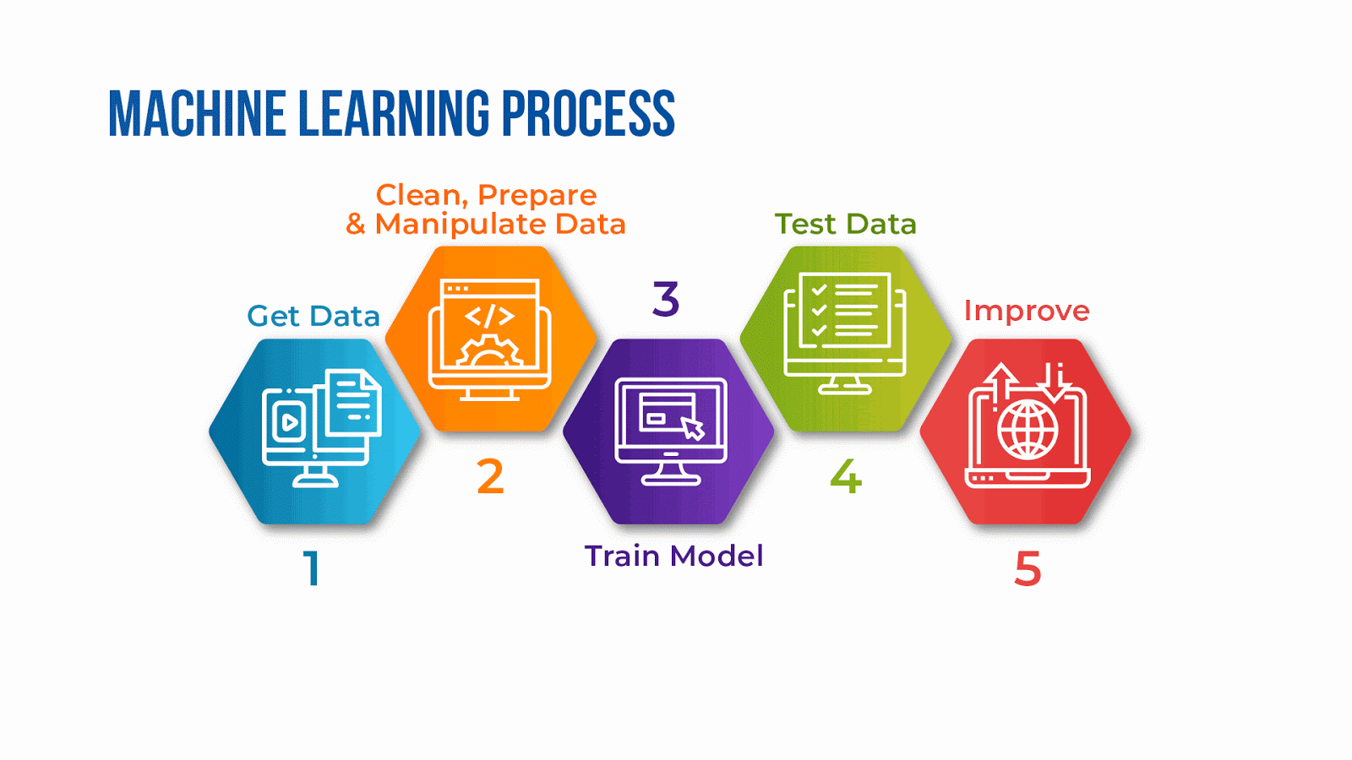
METHADOLOGY
Get data Cervical cancer dataset from UCI ML repository (https://archive.ics.uci.edu/ml/datasets/Cervical+cancer+%28Risk+Factors%29)
2. Data cleaning & eda Impute missing values by mean Identify the corelation factors using correlation matrix Balance the data using SMOTE on training set PCA analysis to get best features Preprocessing data by SKLEARN standard scalar
3. TRAIN MODELS 3 ML models: 1. Logistic Regression, 2.Random Forest & 3. Super learner Ensemble method (Decision Tree & Bagging as base learners with XGBoost as meta learner) 3 predictive models for each ML models: 1. Model built without PCA & SMOTE, 2. Model with PCA only, & 3. Model with SMOTE only.

Slide 5
METHADOLOGY -cont.
4. Evaluate & Compare MODELS Impact of SMOTE and PCA technologies on models performance were compared
Access the accuracy and sensitivity of the three ML models by:
Confusion matrix: sensitivity (recall), specificity, F1-score, positive predictive accuracy (PPA) & negative predictive accuracy (NPA)
Receiver operating characteristic (ROC) curve & area under curve (AUC)

Slide 6
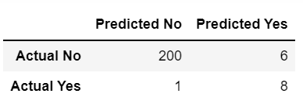
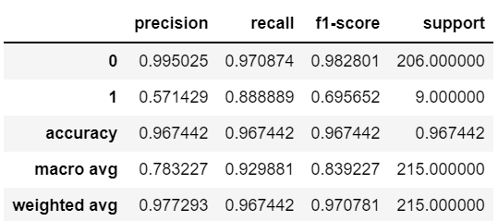
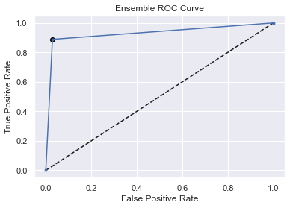
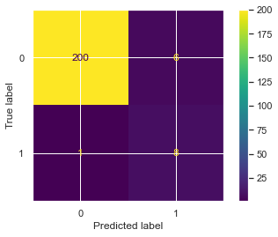
Results
Super Learner Ensemble Method (Decision Tree & Bagging as base learners with XGBoost as meta learner) without PCA & SMOTE
CONFUSION MATRIX
ROC & AUC
Ensemble ROC-AUC score: 0.929

Slide 7
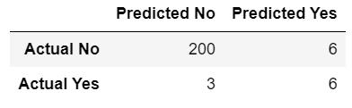
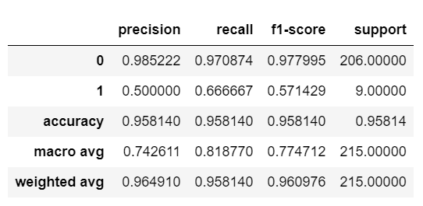
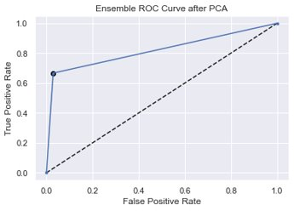
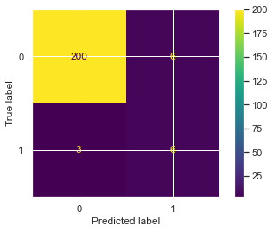
Results
Super Learner Ensemble Method (Decision Tree & Bagging as base learners with XGBoost as meta learner) with PCA
CONFUSION MATRIX
ROC & AUC
Ensemble ROC-AUC score with PCA: 0.818

Slide 8
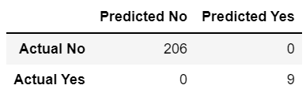
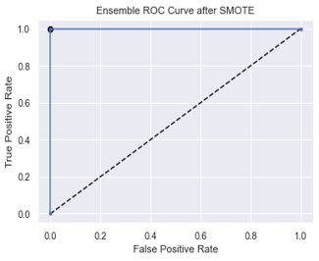
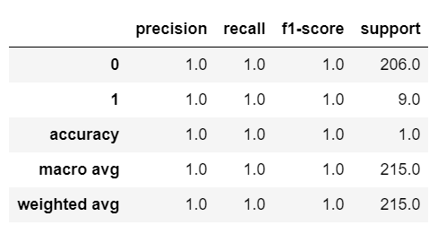
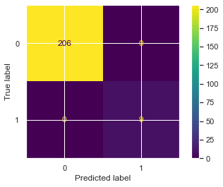
Results
Super Learner Ensemble Method (Decision Tree & Bagging as base learners with XGBoost as meta learner) after SMOTE
CONFUSION MATRIX
ROC & AUC
Ensemble ROC-AUC score after SMOTE: 1.0

Slide 9
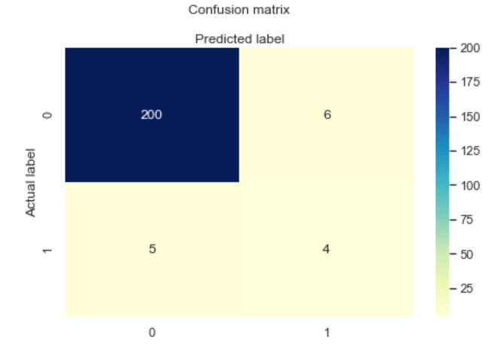
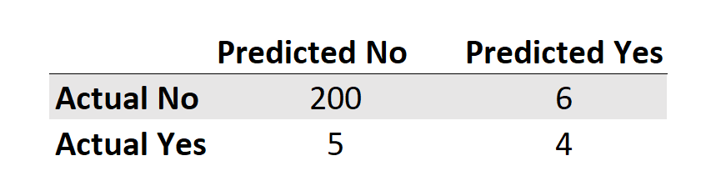
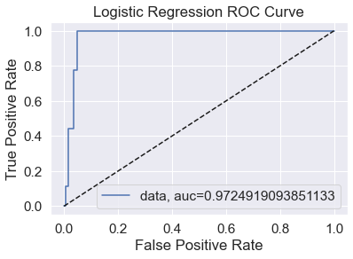

Results –Logistic Regression (RICHA)
CONFUSION MATRIX
ROC & AUC
Logistic Regression Method without PCA & SMOTE : 0.97

Slide 10
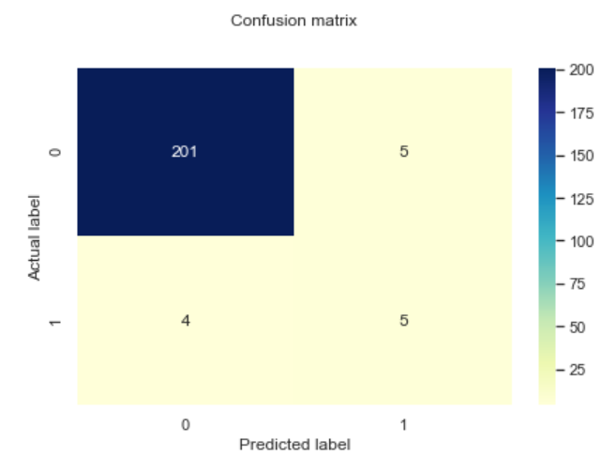
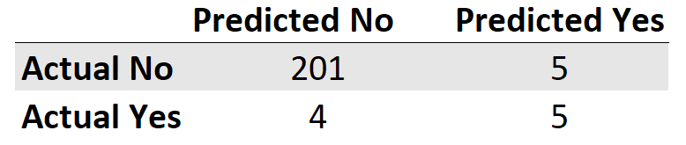
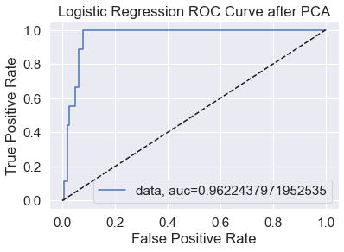

Results –Logistic Regression
CONFUSION MATRIX
ROC & AUC
Logistic Regression Method with PCA : 0.96

Slide 11
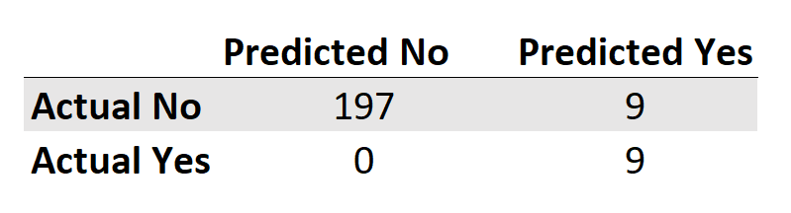
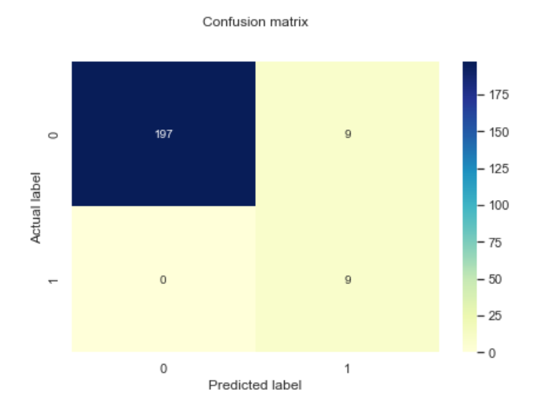
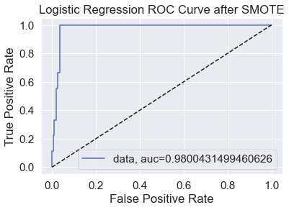
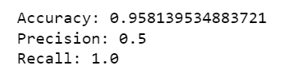
Results –Logistic Regression
CONFUSION MATRIX
ROC & AUC
Logistic Regression Method with SMOTE : 0.97

Slide 12
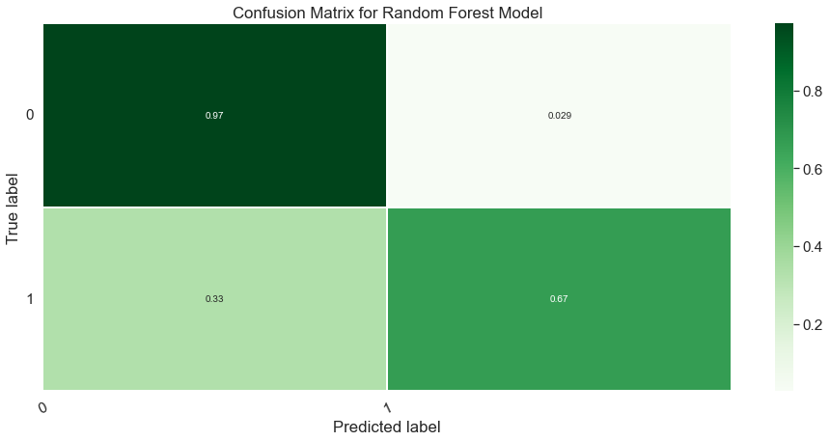
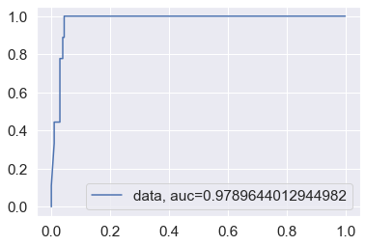
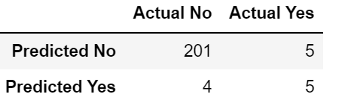
Results
Random Forest Method without PCA & SMOTE
CONFUSION MATRIX
ROC & AUC
Random Forest ROC-AUC score: 0.979

Slide 13
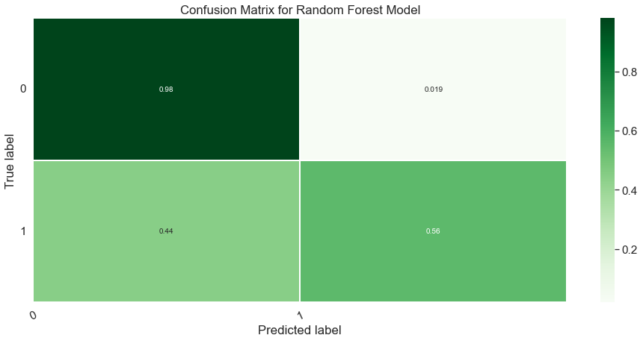
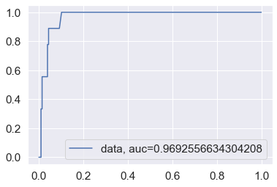
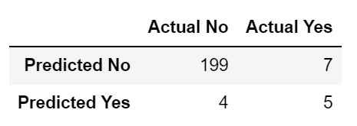
Results
Random Forest Method with PCA
CONFUSION MATRIX
ROC & AUC
Random Forest ROC-AUC score with PCA: 0.969

Slide 14
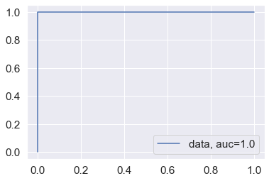
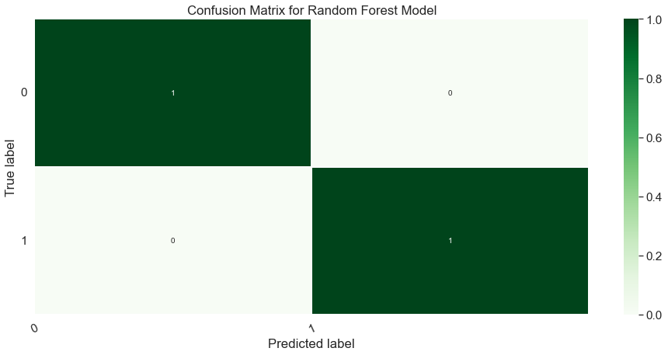
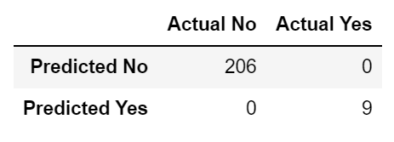
Results
Random Forest Method after SMOTE
CONFUSION MATRIX
ROC & AUC
Random Forest ROC-AUC score after SMOTE: 1.0

Slide 15
CONCUSION
It is found that both Custom Ensemble model and Random Forest with SMOTE had 100% accuracy and high sensitivity in predicting cervical cancer through biopsy, however we believe that there may be some overfitting happening. It is recommended that some additional steps be taken like feature engineering to get a deeper look into this. The second best model was the ensemble method without PCA and SMOTE. Best Model: Custom Ensemble Model: Super learner Ensemble method (Base learners: Decision Tree & Bagging & XGBoost as meta learner) without PCA & SMOTE with 97% accuracy and AUC-ROC -score of 0.93.
Super Learner Ensemble Method
Logistic Regression
Random Forest
 | Accuracy | Precision | Recall | ROC score | Accuracy | Precision | Recall | ROC score | Accuracy | Precision | Recall | ROC score
1. Model without PCA or SMOTE | 97% | 0.88 | 0.57 | 0.93 | 94% | 0.4 | 0.44 | 0.97 | 0.96 | .5 | .55 | .98
2. Model with PCA | 96% | 0.78 | 0.54 | 0.87 | 95% | 0.4 | 0.44 | 0.96 | 0.95 | .45 | .55 | .97
3. Model with SMOTE only | 100% | 1.0 | 1.0 | 1.0 | 95% | 0.5 | 1.0 | 0.98 | 1.0 | 1.0 | 1.0 | 1.0

Slide 16


